Slide 1

Weatherstation MQTT Docker Node Red InfluxDB
Joris Van puyenbroeck
1 OHO - IT Essentials

Slide 2
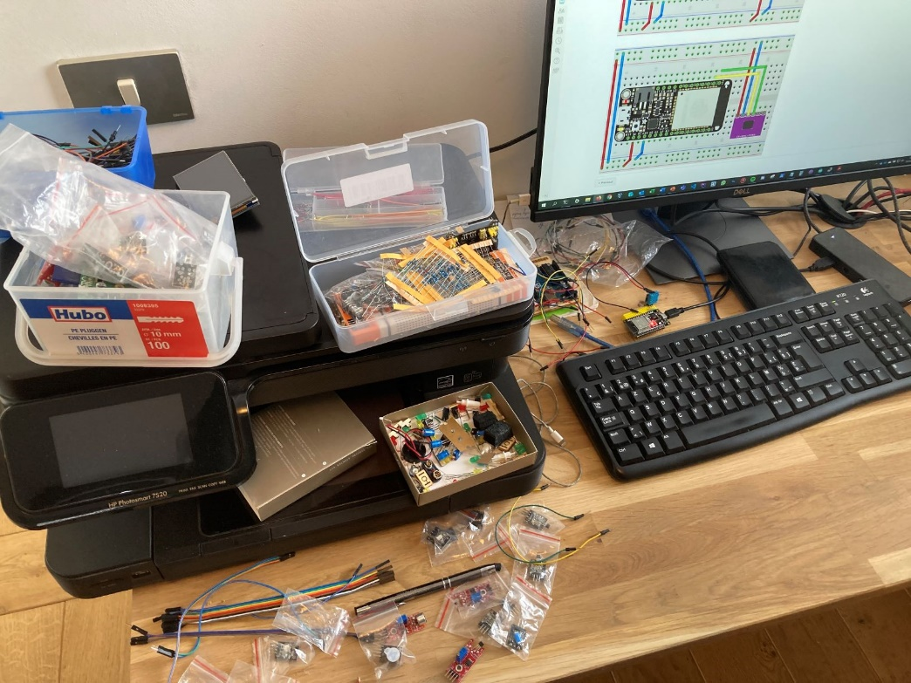
Word in advance
ESP32 : already some experience, small experiments
Thanks to this project , I learned C basics
Some header dependency troubles → Arduino IDE
I love IoT !

Slide 3
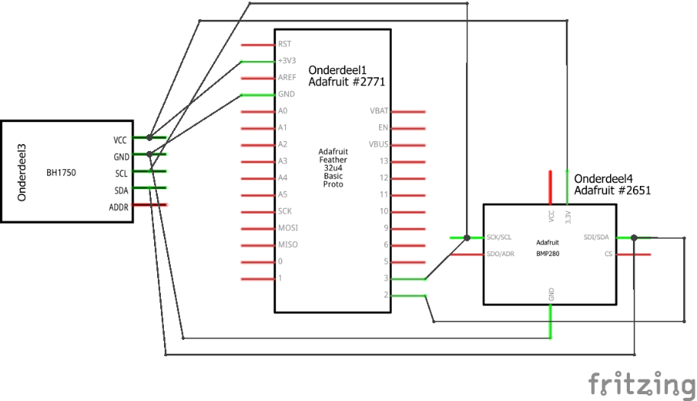
Block diagram

Slide 4
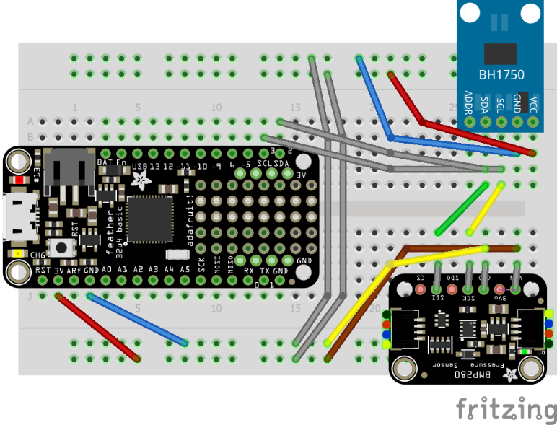
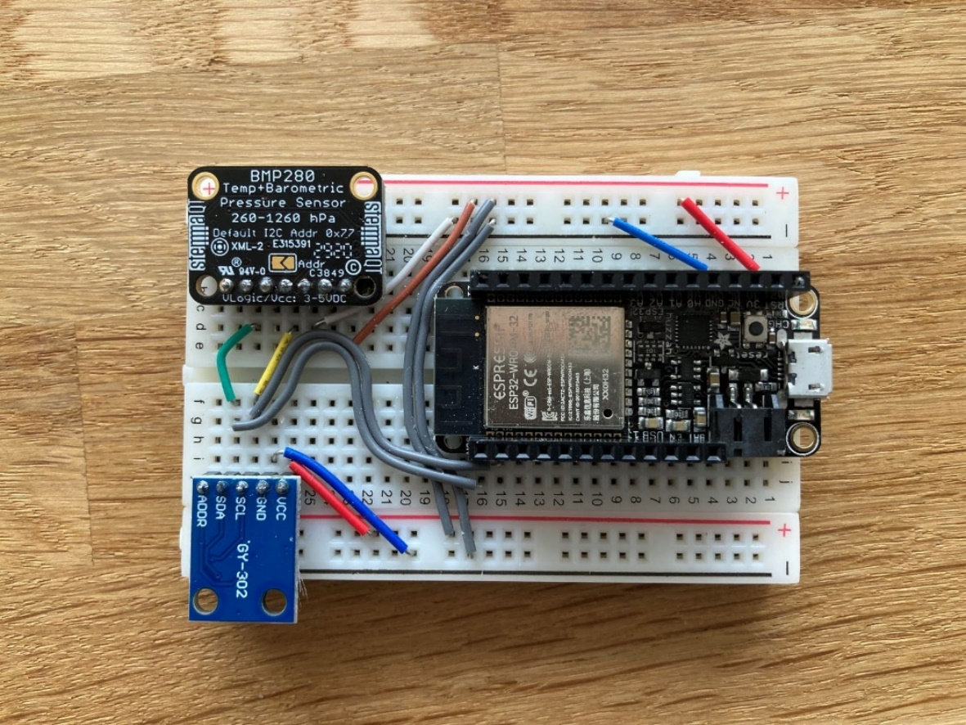
Wiring

Slide 5
First Steps
Sketch | Tested functionality | Technology, headers, snippets of important code
sketch_esp32_blink | Serial Com Upload Building environment Led blinking | Arduino.h | ☑
sketch_bmp280_ BH1750_serial | Two sensors connected Serial output 3 sensor readings in void loop | Wire.h Adafruit_bmp280.h BH1750.h | ☑
sketch_esp_dash_ BMP280_BH1750 (local webserver on ESP32) | WiFi ESP32 Asynch webserver Dash webpage in void loop | Wifi.h asyncTCP.h ESPAsyncWebServer.h ESPdash.h | ☑
sketch_esp_dash_ 3sensors_deepsleep | Deep sleep and wake up by timer | #define TIME_TO_SLEEP esp_deep_sleep_start() | ☑

Slide 6
Towards the final target
sketch_SQl_sinners_ 3sensors_deepsleep | httpconnection PHP code to write to MySQL database on db.sinners.be https://jorisvp.sinners.be/ITessentials/esp_chart.php | HTTPClient.h http.POST(httpRequestData) (PHP) $conn = new mysqli($servername, $username, $password, $dbname) $conn->query($sql) | ☑
sketch_mqtt_light | MQTT with one sensor Output to Thingspeak | Timelib.h Pubsubclient.h client.setServer(mqtt_server, 1883 client.publish(outTopic, attributes) | ☑
sketch_station2_ DHT11_BH1750_MQTT | second board to safely test the MQTT approach DHT11 Aliexpress sensor (not i2c) Output to local and remote MQTT broker First tests with local MQTT server on Docker NAS Synology 918+ | DHT.h Mosquitto (local MQTT) Synology DSM package | ☑
sketch_weatherstation _wittenberg | Integration of all steps Connection to sinners.be Connection to MQTT broker Node Red on local server (Synology Docker) Output to Thingspeak (remote) https://thingspeak.com/channels/1318816 Output to local Node red chart (local) Output to local InfluxDB Deep sleep set to 30mins | ArduinoJson.h Docker (LAN) Node Red (local webserver) Msg.payload = () JSON and Javascript objects InfluxDB on Docker Grafana on Docker Telegraf (experiments) | ☑

Slide 7
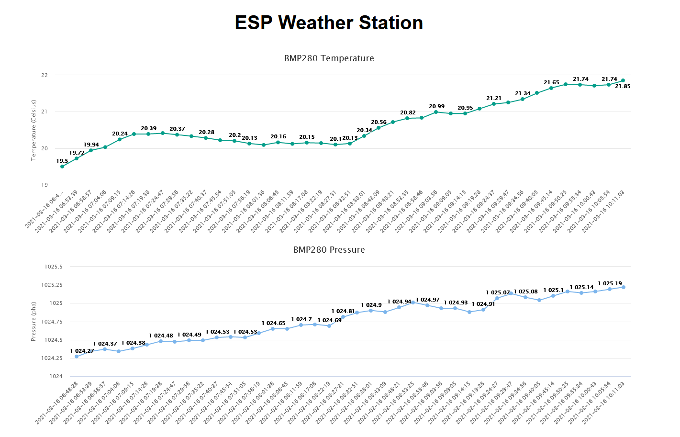
PHP - SQL on sinners.be

Slide 8
Visualization of current and historical data by communication over MQTT
MQTT broker
subscribe
publish
Tested locally and remotely, used Client MQTT FX (win) for debugging
client.publish("esp32_wittenberg/temperature", tempString);
client.publish("esp32_wittenberg/pressure", presString);
client.publish("esp32_wittenberg/light", lightString);

Slide 9
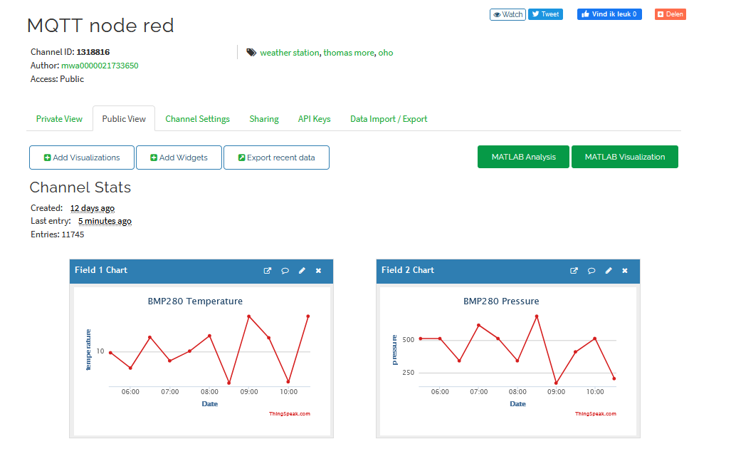
Thingspeak

Slide 10
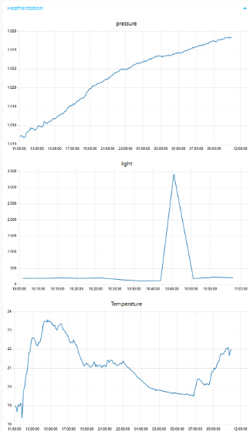
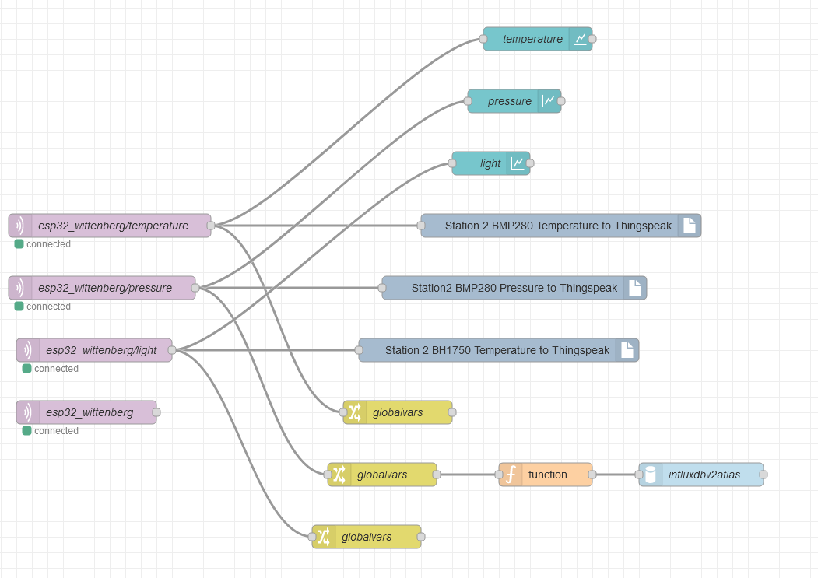
Node RED (docker on Synology 918+)

Slide 11
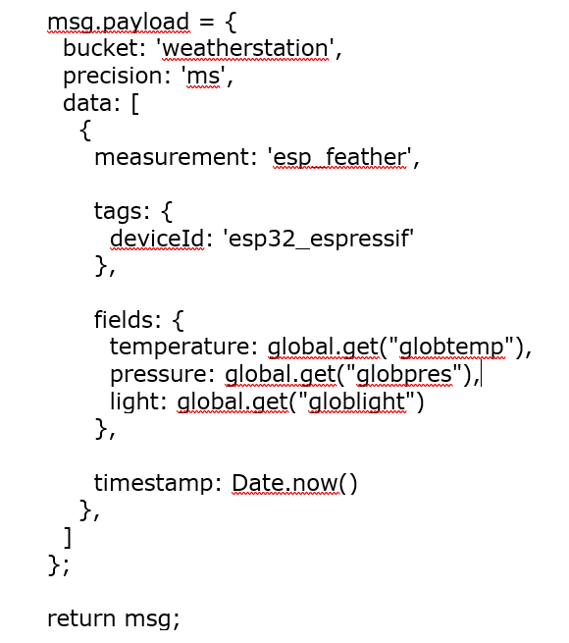
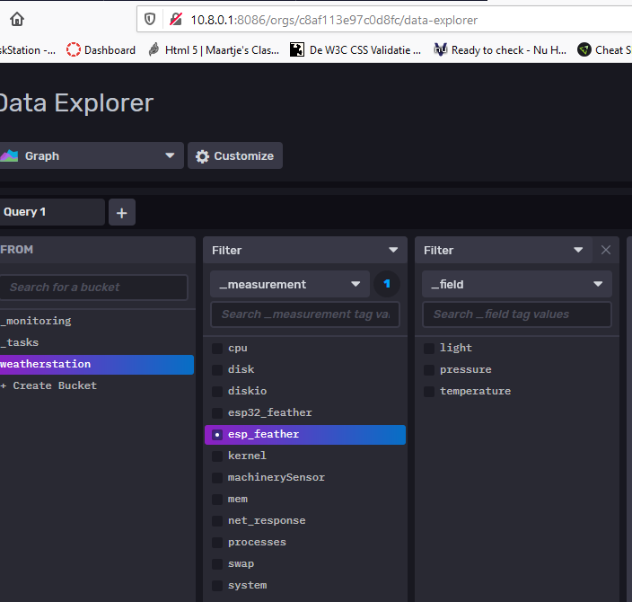
INFluxDB on docker
- on VPN network (so accessible remotely)
- Influx v2 is completely different than v1
- it has client libraries for ESP32 but i wanted this via MQTT and Node Red

Slide 12
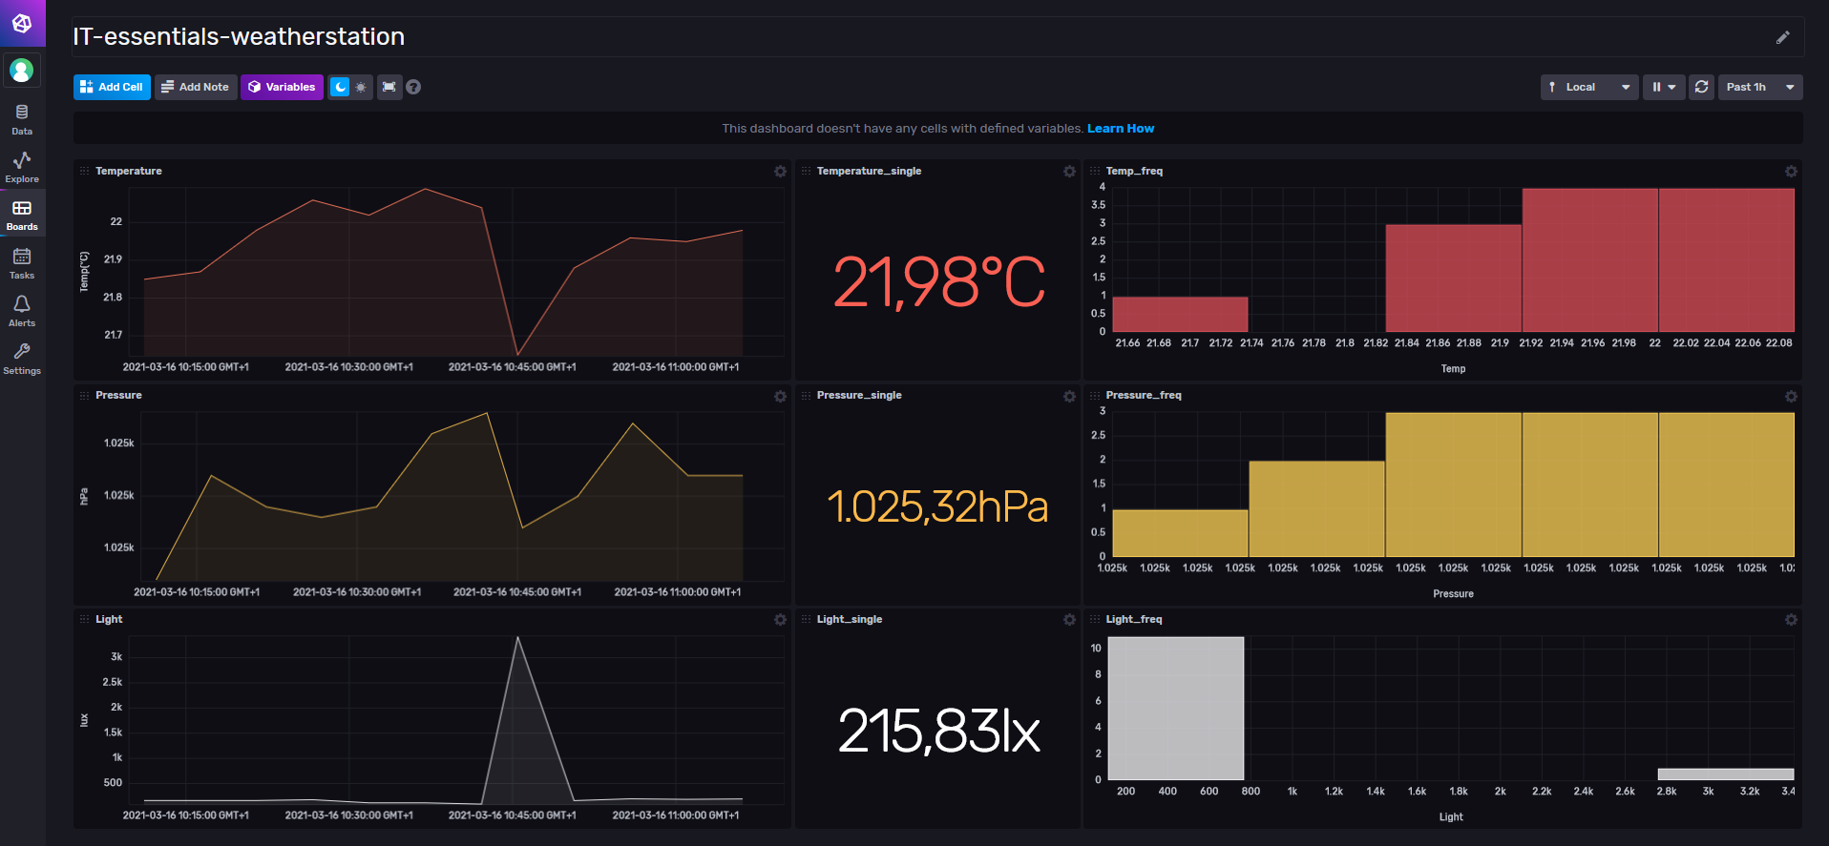
Dashboard

